Slide 1


Slide 2

Welcome to HMP/YOI Moorland
Houseblock 2 Induction Unit

Slide 3


Equal Opportunities and Discrimination Statement
HMP &YOI Moorland is committed to promoting and practicing diversity and equality of opportunity and aims to create a culture and environment where staff and prisoners are treated equitably regardless of age, disability, gender, marital status, pregnancy and maternity, race, religion or belief, sexual orientation or any other irrelevant factor.
All staff and Prisoners at Moorland have a right to work and live in an environment which is free from harassment, unlawful discrimination, victimisation and bullying. Similarly, visitors and others who come into contact with staff are entitled to be treated with fairness and courtesy.
It is our aim to build an establishment that understands, appreciates and values the diversity of each individual and incorporates measures that make people feel valued and able to participate and achieve their full potential.
Cases of discrimination on any of the above grounds are offences under the Prison Service Code of Conduct and Discipline; some are illegal and subject to law.
They will not be tolerated and will lead to disciplinary proceedings.

Slide 4

Induction Process
The purpose of this induction is to help you make the transition from your previous establishment to the regime at Moorlands as quickly and smoothly as possible.
We aim to make you aware of the full induction process where we will explain certain prison rules and procedures that affect you and the opportunities available to you at Moorland.

Slide 5


Display of Images
You may display images that are acceptable for public display ONLY.
Images of nakedness, images of sexually explicit depictions, images which could be considered to be discriminatory on race, ethnicity, sexual orientation, disability, sex or religious grounds will not be tolerated.
Derogatory depictions, language or behaviour that offends any member of staff, prisoner or visitor will not be tolerated.
If any of these images are found displayed by you in your cell or if you put them in a public place disciplinary action will taken if when asked you refuse to remove them.
Please be mindful of others and remember that you may not find something offensive but others may. If you think that something you are about to display could be considered offensive to others check with a member of staff first.

Slide 6
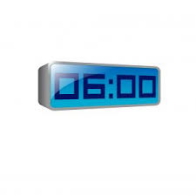
Early Count
Before night staff go off duty around 6am a roll check must be done.
We have to ensure we get a response from every prisoner in every cell.
When you hear a member of staff at this time please move your arm or leg or any part of your body so we know you are ok.
If a response can not be seen at this time the member of staff will stay there until they get acknowledgment that you are ok.
This is for your safety and wellbeing please cooperate with this procedure.

Slide 7

Moving off the Induction Unit
Once your induction process has been completed on this unit you will then be moved to the main residential units.
Movement off the induction unit is a must to allow a safe and swift integration in to the main population and to allow you the opportunities to work, have access to education and all the other opportunities available to you at Moorland.
The population level in all prisons is high and because of this movement off the induction unit is carefully selected by induction staff. You will be move to the spaces available on the day.
We try to move people off the unit in the order in which they arrived. This may not always be possible and it may appear someone has moved off the unit before you. Operational reasons will occasionally dictate the order in which people move off some of these reasons are; if a prisoner is a non-smoker or smoker, the Cell sharing risk assessment, return from court or a number of other factors.
Moving you to a location of your choice is not an option we have a limited number of spaces on a daily basis and these are the spaces we must use.
Failure to comply with this will result in automatic basic and an adjudication.
Please be patient and respectful to the staff moving you.

Slide 8

I.D Cards
You will be issued with an I.D. Card whilst on the induction unit.
These cards MUST be carried with you at all times, treatments, gym and activities can not be accessed without them.
If you are asked by a member of staff to show them your I.D. Card you should be able to produce it at any time on or off the Houseblock.
Should you require a replacement I.D. Card YOU will be charged £2.50.

Slide 9

PID Workers (Prisoner Information Desk)
PID Workers are available by request or there are separate offices on each Houseblock where the PID worker will be during the day.
They are there to help with applications.
They have access to the PSO/PSI and notice to prisoner.
Other things PID Workers do include;
To Help Prisoners Fill Out Forms
Access Services
Pass on Prison Knowledge
Give Advice
Hold and Give Out Blank Applications
Collate Applications
Be available to Prisoners at All Times When Unlocked
Have High Visibility
Have a Good, Friendly and Happy to Help Attitude
Be Patient and Approachable
Abide By The Equality's Policy

Slide 10


Applications Process
Applications are available from your wing PID worker.
Completed applications should be handed back to the PID worker, they will then give it a reference number make sure they are filled in correctly and then hand them to staff to be sent to the correct department.
Medical applications are to be placed in the medical box outside the treatment room.
Discrimination forms (DIRF) are to be placed in the yellow confidential access box located at the end of the landing on each wing.
Request and Complaints forms (Comp 1, Comp 1a etc.…) are placed in the same box as the DIRF forms.
Answered application forms will be returned to you in your cell.

Slide 11



















Religious Services
All Religious services are held in the main chapel.
Church of England service is on a Sunday morning at 10:30am.
Roman Catholic Service is on Sunday morning at 09:30am.
Roman Catholic Mass is on Friday morning at 09:00am.
Muslim Service is on a Friday afternoon at 13:00pm.
You must be registered in your respective religion to take part in these services.

Slide 12

Gym
You must complete your gym induction before being able to access the gym.
You will be called for the gym induction course when it is your turn. The induction staff will inform the gym of all new arrivals.
Some of the benefits of using the gym are;
Reduce the risk of obesity, cardiovascular disease, strokes, osteoarthritis and osteoporosis, Improve self esteem and self confidence, Improve mental alertness, Improve self esteem and self confidence, Improve mental alertness, Reduce frustration, Reduce anxiety and stress, Make new friends, Improve team skills, Improve mobility and flexibility, Increase strength and stamina and Improve heart and lung function.

Slide 13

Telephone System
You have already signed during the Reception process or had explained to you the Interception of Communications Compact, a legal requirement.
All calls are recorded and may be monitored, calls are subject to random monitoring at up to 5%, some calls are not monitored this includes calls to your Legal Advisors, MP’s, Samaritans Etc.… as mentioned in your compact.
Telephones are run on a pin number system.
Phones are to be used on association periods only.
There is no need to book use of the telephones as we expect you to be sensible about the amount of time you spend on the phone and take into consideration other people.(any abuse of this will lead to the introduction of phone lists where staff will tell you when you can use the phone and for how long).
Requests to use the phone outside the prescribed periods will be done by application process only.
Inter-prison phone calls are permitted at your own expense and must be applied for on the appropriate application form.
Foreign Nationals or those with ties abroad are allowed £5 pin credit onto their Foreign National pin account, if they have not received a visit in the previous month. This is by application only.
Do not let anyone use your pin number.
Any misuse of the pin phone system will result in disciplinary action.

Slide 14


Email a Prisoner www.emailaprisoner.com
This is a service where your family or friends can send an email to you in prison.
Staff will print out the message and deliver it to you the next day.
There is no cost to you, it will cost the sender 30p (less than a first class stamp).

Slide 15
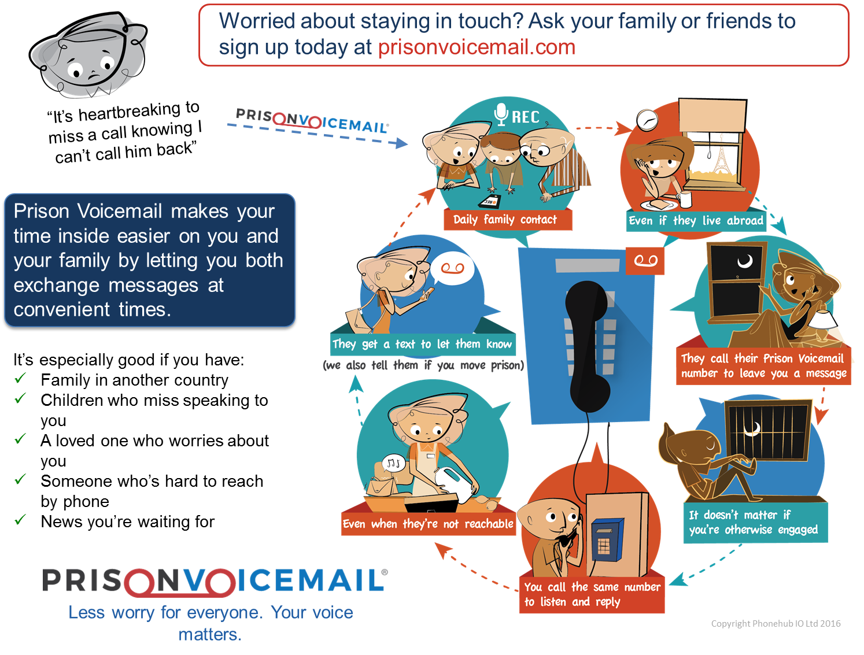

Slide 16
Mail
Every prisoner will receive a weekly letter. This letter is second class postage and is paid for by the prison.
All outgoing mail must have your name and number on the back of the envelope or it will not be sent out.
Do not seal your outgoing mail, other than mail subject to legal privileged letters.
Incoming mail is opened and checked (except for official mail i.e. Legal mail’, MP’s letters ect… as long as they are clearly marked.
Up to 5% of incoming and outgoing mail is checked as a matter of course.
Email a prisoner operates on the same screening as normal mail and is checked at the same 5% level.
Cheques and Postal Orders must be made payable to the governor and have the senders name and address on the back.
Mail boxes are emptied during the night and mail is sent out the next day unless it is a weekend or a bank holiday when it is sent the next working day.

Slide 17

Visits
Visits can be booked by telephone or at www.gov.uk/prisonvisits.
All visitors will have to be registered prior to booking a visit. You can add visitors details by using the correct application form.
Once your visitors details have been added they will follow you from one prison to another in the case of you being transferred.
There are no visits on Mondays, Tuesdays and Fridays.
Visits must be booked 48 hours in advance.
The visits centre opens at 12:30 and Visits are conducted 14:00 to 16:00.
Visitors have until 15:00 to arrive after that entrance to the prison will not be permitted.
A canteen and vending machines are available in the visits room.
Your Visiting order allowance varies depending on your IEP Level.
Further information on this can be found in your induction booklet.
Assisted prison visits information booklet is available from your induction or wing staff.

Slide 18

Canteen and Money
The canteen service is run by DHL. Your canteen sheet contains all the codes for ordering items and their prices.
Canteen sheets are delivered to your cells on a Friday afternoon and should be completed and handed back in to wing staff no later than lunch time Sunday. Any canteen sheets handed in after this time will not be processed and can not be added to the order. YOU WILL NOT RECEIVE A CANTEEN THAT WEEK.
Canteen delivery takes place on a Wednesday.
You must fill your sheet out in black pen only.
Your money will be transferred from your previous establishment automatically, however if you are arriving from a private prison this will take longer than if you have arrived from a public prison, due to them using a different system.
You will be offered a reception pack on arrival which includes a Smokers or Non-Smokers pack and £2 pin credit. This will be paid back in a lump sum from your spends account should there be sufficient funds to cover it.
You can have transferred £15.50 if on Standard and £25.50 if Enhanced from your private account to your spends weekly.
Weekly canteen allowances are £35 on Standard and £50 if Enhanced.

Slide 19

Menu’s and Meal Times
Meals are selected by you from the menu sheet that will be displayed in you wing office.
New sheets will go up every Wednesday evening and you have until Saturday tea time to complete and return it to wing staff to be signed.
All menu sheets must be dated for the following Thursday (the day the new menu starts).
If you fail to complete the menu you will be given a default choice of No.2 choice for every meal that week.
You must fill in a menu sheet as soon as possible on arrival to allow staff enough time to log it for the following day.
Always keep your copy of the menu sheet as you may need it at a future date if you have any problems with your meal choices.
When unlocked for meals you must wear appropriate clothing and footwear to collect you meal, always take your tray plate and bowl.
One trip to the severy only.
Please do not loiter or slow time in the server area when collecting your meal as there are a lot of prisoner to meals.
Special diets are offered for medical or religious reasons.

Slide 20

Association
Association is every weekday evening apart from Friday when it runs all afternoon.
Association starts after you evening meal has been served.
The end of association will be called and you are expected to return to your cells promptly.
During association you are expected to be fully dressed at all times INCLUDING to and from the showers.
Smoking is permitted in your cell and on the exercise yard ONLY.
Slippers and flip flops are for in shower or in cell use only they are not appropriate footwear for the landing.
Failure to abide by these simple rules will result in IEP Warning and a possible downgrade of your IEP Level.

Slide 21
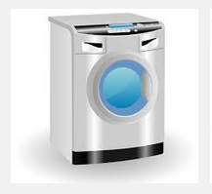
Kit Exchange and Laundry
Prison Kit is exchanged once a week every week. Each Houseblock has its own day and will vary depending on which Houseblock you go to.
You must put your dirt laundry into the kitbag you were provided in reception along with a kit exchange slip (available from your PID Worker) detailing what you have put in the bag.
Once you have completed the slip and your washing is ready take it to the ones landing and place it tidily by the gates ready for collection.
This is then taken to stores and changed for clean kit which will be delivered to your cell later that day.
Houseblock laundry is for personal clothing only NOT Prison issues. This is done on weekdays only.
When it is your wings turn for laundry place your laundry inside you kitbag and Clearly mark that it is yours.
First thing in the morning either give the laundry to the laundry worker or take it to the laundry for washing.
When you collect your tea the clean and dry washing will be waiting for you in the server area.
Personal kit is washed at your own risk and the prison will not take responsibility for lost or damaged kit.

Slide 22


Slide 23
Requests and Complaints
HMP Moorlands has an effective system in place. It is intended to inspire confidence in addressing needs and to improve your welfare. It is designed to reduce stress and anxiety and promote good relationships.
The system is open and is simple to use and understand. There is easy access at all times. All steps in the process are time bound and the system promotes fairness.
It is intended that the appropriate levels redress are arrived at and all submissions will achieve an appropriate level of response.
The system is confidential and you will not be treated differently because you have made a complaint.
Forms are freely available on the landings by the yellow metal box.
Form 1 White – Ordinary / initial
Form 1a White – Appeals
Form 2 – confidential access
Once complete please put the form in the yellow box provided.
Forms should be submitted within 3 months of the incident and the initial response within 3 working weekdays for white 1 forms.

Slide 24

IMB
The IMB are responsible to the secretary of state, every prison in England and Wales has its own IMB who are volunteers that work on a rotational basis.
The IMB is an independent body which monitors the day to day life in prison.
We are no part of the prison service.
We have a constitution and purpose which is displayed on the notice boards on your wing.
Principle Duties
To satisfy ourselves as to the state of the prison premises.
The administration of the prison and the treatment of the prisoners.
To direct the attention of the governor to any matters which call for his/her attention and to bring to the attention of the secretary of state any matters considered expedient to report.
To attend any major incident and monitor how it is dealt with.

Slide 25

Particular Duties.
To hear complaints.
Inspect food at frequent intervals.
Enquire into any report ref; Health, either physical or mental.
Monitor segregation.
Be present at any major incident.
Compalaints.
There is a formal system for complaints, these should normally be addressed through the prison request complaints procedure.
If this proves to be unsatisfactory or if for some reason you do not believe this route to be acceptable then the special IMB request and complaints forms are available on each wing.
It is also possible to approach any member of the IMB when they are visiting. However a written application will also need to be made.
Finally
They are here to see that you get what you are entitled to not what you want.

Slide 26

The Prison Ombudsman
Appointed by the home office not the prison service and an Independent point of appeal for internal complaints.
Can Consider:
Individual decisions taken against prisoners.
Cannot examine clinical decisions of doctors.
Contact by:
Letter
Special application
Will look at cases 12 months after an incident providing all internal avenues have been used. The Ombudsman is confidential.
Examples of cases dealt with:
Ex gratia payment for lost property.
Gaining redress for actions of injustice.
Mitigation of unjust adjudication awards.

Slide 27

Criminal Cases Review Commission (CCRC)
The Commission can review the following matters:
A Conviction and sentence made by the Crown Court.
A Conviction and sentence made by the Magistrates Court.
A verdict of not guilty by reason of insanity.
A finding that a person is under a disability but did the act charged.
The commissions jurisdiction covers England, Wales and Northern Ireland.
The commission can not overturn a conviction or change a sentence. Its roll is to examine cases to identify those where it appears that the original conviction maybe unsafe.

Slide 28

Offender Management Unit
Upon your arrival at Moorlands you will be allocated an Offender supervisor who will see you within 2 to 3 weeks of your arrival.
Applications are available should you need to contact them after you have initially met them.
HDC / Cat D / ROTL
Your Offender Supervisor will arrange this automatically for you or advise you what you need to do should you be eligible for HDC / Cat D or ROTL.

Slide 29
IEP System
Enhanced
Basic
Standard
Prisoners that arrive at Moorlands will retain their IEP status from their last establishment.
You can move up or down the IEP levels.
To move up you must remain free of write ups and adjudications for a period of 3 months and take part in your sentence planning targets. Have positive interactions with staff and comments to that effect on your wing file.
To be moved down you will have displayed a pattern of poor behaviour or been found guilty of a serious breech of prison rules e.g. proved adjudications for hooch, drugs, assaults or failing to move off the induction unit.
A two tier downgrade is possible for a single serious incident.

Slide 30
IEP System, How It Works
Enhanced
Basic
Standard
Two Tier Downgrade Is Possible For A Single Serious Incident

Slide 31

Searching Procedures
Policy Statement.
In line with Prison Rules 1999 any person or vehicle entering or leaving HMP Moorland may be stopped, examined and searched.
All prisoners will, at various times be subject to searching procedures.
Searches will include:
Full searches
Rub down searches
Pat down searches
Searches of wing accommodation
In particular searches will be carried out at the following times:
On reception
Before and after visits
Before and after activities
On discharge
All searches shall be carried out in as seemly a manner as is consistent with discovering anything concealed. You will be told exactly what the procedures are at all times.

Slide 32
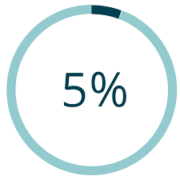
Mandatory Drug Testing (MDT)
Section 16a of the Prison Act 1952 allows Prison Officers in any Prison for which an authorisation from the Governor is in force to require prisoners to provide a sample to be tested for the presence of drugs.
All categories of prisoners will be tested, testing will be carried out in the following ways:
Random Testing
5% of the prison population will be tested each month from a randomly generated computer list.
Reasonable Suspicion
If there are grounds to suspect you have recently taken drugs
Frequent Testing
This will apply to those prisoners found to regularly misuse drugs
Reception Testing
You may be tested on initial reception or transfer and in relation to risk / temporary absence

Slide 33
MDT Continued
Risk assessment
To be assessed for release on temporary licence / HDC or ROTL
What will happen if I test positive, I refuse or I am unable to produce a sample?
Prison Rule 51 paragraph 9 makes the taking of controlled drugs a disciplinary offence, If you provide a sample that tests positive you may be placed on report.
Those prisoners who refuse to provide a sample may be placed on report under Prison Rule 51 paragraph 22 “Disobeys a lawful order”.
Those prisoners who state they are unable to provide a sample can be confined for a period (not exceeding 5 hours) under arrangements contained in Rule 50 (7). If at that time they still claim to be unable to produce a sample they will be treated as refusing.
A member of Healthcare will be called to assess you if you are having difficulties.

Slide 34
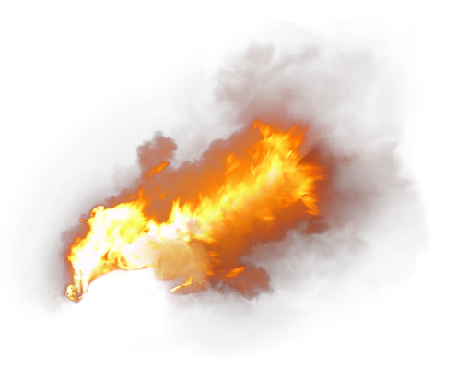
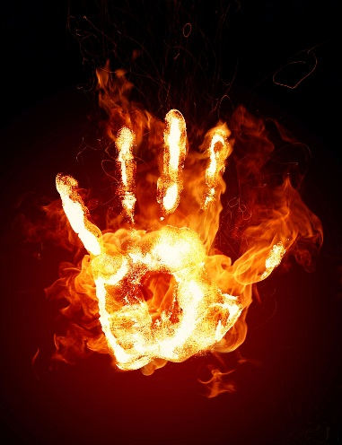
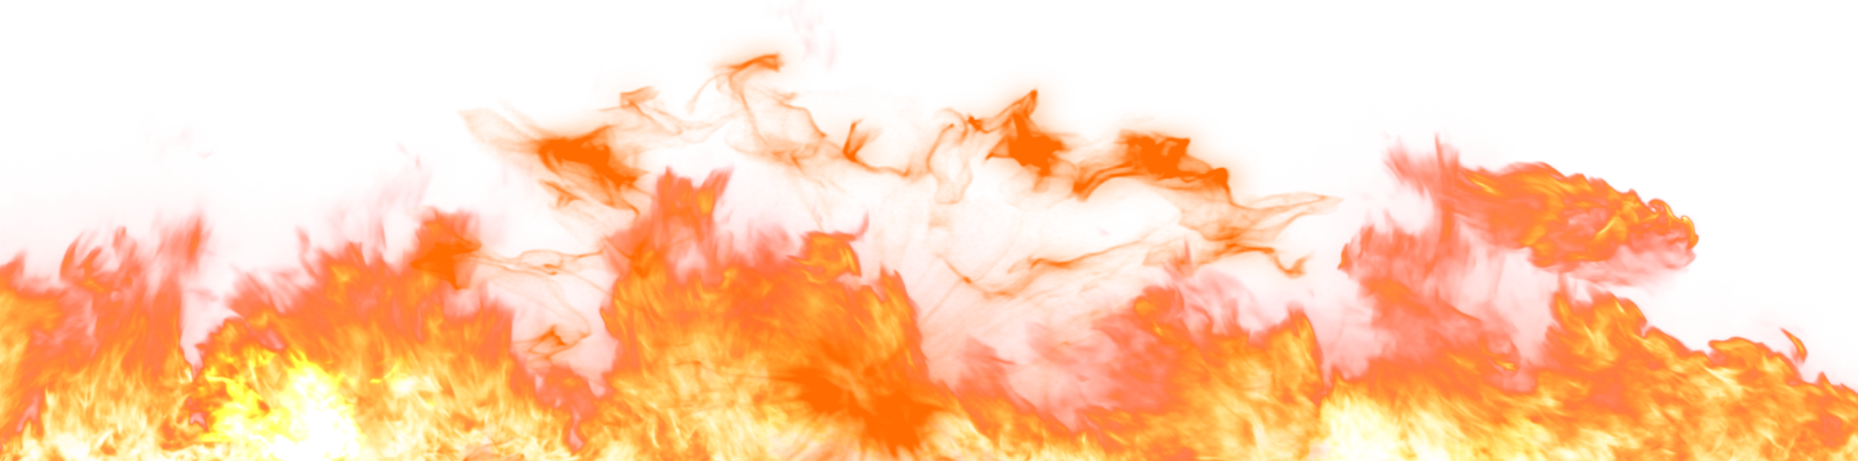
Fire
In the event of a fire when you are in your cell and staff need to evacuate you keep calm, staff will open your door don’t stop and pick anything up, don’t run, go where you are directed it is important that staff can account for everyone.
Your primary evacuation area is always onto the exercise yard but if for any reason you cant get to the yard the secondary area is onto the secure walkway.

Slide 35
Arson
Introduction
At HMP & YOI Moorland staff, prisoners and contractors are committed to ensuring that a safe, decent and secure environment is provided for all that work and reside here.
What is Arson?
Arson is defined as “wilful setting on fire of property” whether this is intentionally or recklessly to damage property or endanger life.
What are the consequences to Arsonists?
As arson is a criminal act, every effort will be made to obtain a conviction for the offence through the Courts. If arson is established, the perpetrator will be placed on the establishment’s Arsonist List, an ACCT will be opened and your cell sharing risk assessment will be reviewed.

Slide 36
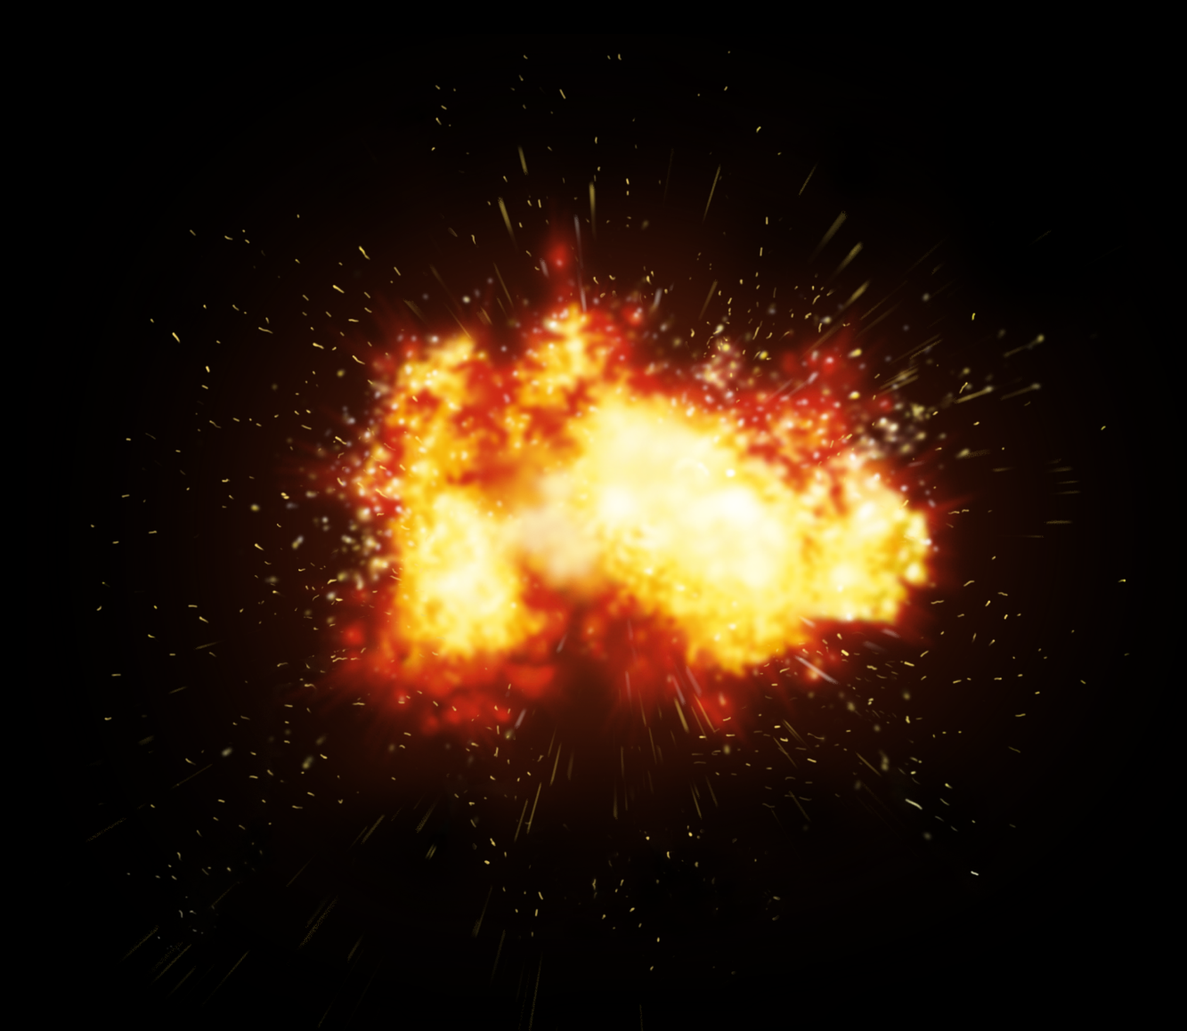
Arson
Cell Fires May Cost You Your Life
Anyone who set fires must consider that help can only be obtained from the Staff on the wing. Staff are trained to put out a cell/room fire, however and unfortunately no matter how quickly they carry out this process, the consequences to you could be fatal.
Smoke inhalation is responsible for a large percentage of deaths caused by fire, as the cell is a relative small area, smoke and heat build-up will be rapid, which will cause loss of consciousness very quickly. If you set a fire you risk your own life; all other occupants within the unit; and those of staff and emergency services who may try to rescue you.

Slide 37
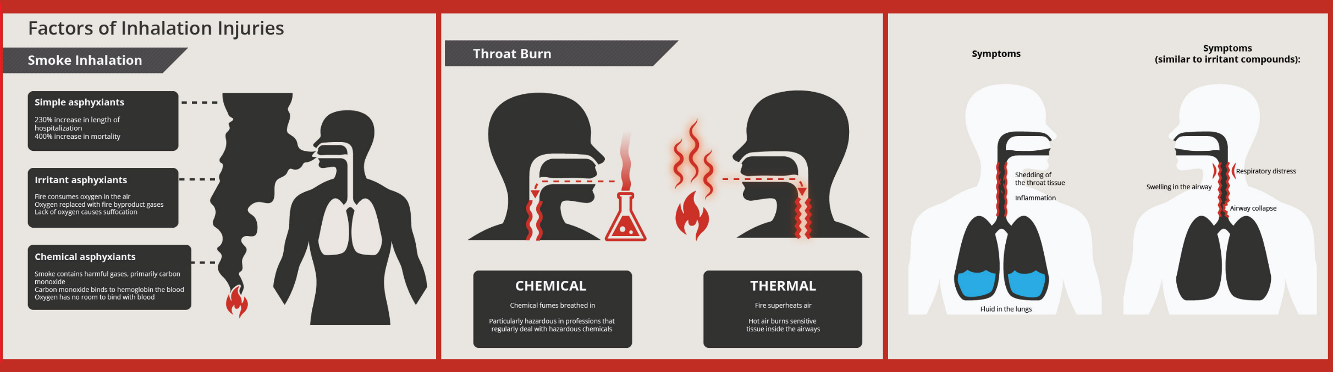
Smoke Inhalation

Slide 38




Employment
At Moorland we offer a wide variety of training and employment opportunities in the workshops and in education.
You can achieve recognised qualifications.
There are around 20 workshops to choose from.
Staff from Manchester collage will speak to you as part of the induction process and will explain what assistance they can give you with seeking employment while you are in custody and upon release.
We also offer workshop learning support to help you improve your educational skills whiles still working and help with any qualifications you may wish to take.

Slide 39


Listeners and Samaritans
Listeners are specially trained Prisoners and are available 24 hours a day.
Listeners are trained by the Samaritans.
Procedures are strictly confidential.
Free phone access to outside Samaritans is available.
Local contact numbers available.
More information is available on Notice boards and from staff.
REMEMBER – THERE IS ALWAYS SOMEONE TO SPEAK TO AT ANY TIME OF THE DAY OR NIGHT!

Slide 40

HMP Moorland has a zero tolerance policy to Bullying this is why…..

Slide 41



HMP Moorland has a zero tolerance policy to Bullying
Bullies will be dealt with through the I.E.P scheme and will suffer loss of privileges.
Taxing will be severely dealt with.
There is no such thing as grassing, if you think that another prisoner has become the victim of bullying tell a member of staff so it can be dealt with.
There is a confidential helpline that is free to use if you aren’t happy or comfortable speaking to a member of staff directly. 0800 496 1364, or you can put an application in to speak to someone from our safer custody team.

Slide 42



Health and Safety
Under Health and Safety Law (The Health and Safety at work act 1974, section 7), we are all responsible for taking reasonable care of our own health and safety.
Section 7 states every person must….
Take reasonable care for the health and safety of themselves and others who maybe affected by their acts or omissions.
Section 8 of the Act states….
No person shall intentionally or recklessly misuse or interfere with anything provided in the interest of health, safety or welfare.
This simply means that ALL OF US have a duty under Health and Safety Law to take care of our own health and safety and that of those around us, either by actions we take or by actions we don’t take (i.e. by not mopping up a spilled liquid ect).
So in Law you must take reasonable care to look after yourself and those around you.

Slide 43

Health and Safety – Personal Protective Equipment.
If your job in prison requires you to wear Personal Protective Equipment (P.P.E) ie…. Safety boots, Protective gloves, Ear plugs, Overalls, Servery whites ect..
You are required under health and safety regulations to wear PPE or clothing provided to you for health and safety purposes. It is not optional you MUST wear them.
If any protective equipment or clothing issued to you is damaged you should then inform a member of staff in your work area to get it replaced.
Remember if you don’t wear protective footwear ect that you have been provided with for health and safety purposes you are breaking health and safety regulations!

Slide 44
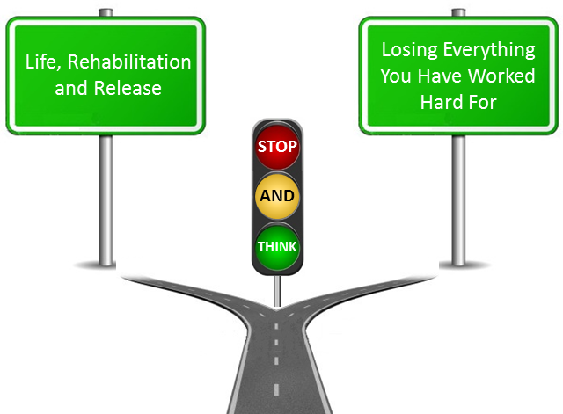
Debt and Debt Management
I will not accept tobacco from anyone
I will not accept drugs from anyone
I will not accept food and drinks from anyone
I will not lend any of my personal possessions with the purpose of exploiting another person.
I understand that gambling is not permitted in this establishment
I understand that being in debt to another prisoner often means the amount owed will be increased on a daily basis and can very quickly grow to a large sums of money.
If I allow myself to get into debt I will be invited to a zero tolerance review. I understand that at the zero tolerance review my IEP, employment and movement around the prison will be reviewed.
If I allow myself to get into debt it will be recorded on my prison record.
I understand that there is no such things as a free gift.
If I have problems with debt I can speak to a wing mediator and members of staff.
I have received enough canteen to last me until I am able to purchase my own canteen.
I agree to pay back the advancement offered to me in reception, this will be taken on a weekly basis.

Slide 45
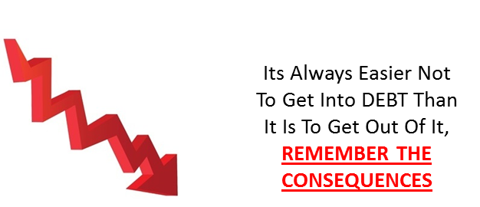
Consequences of Debt
Intimidation,
Double payback (double bubble)
There is no such thing as a free cigarette
It is easy to get into debt and very difficult to get out of.
Being made aware of what you might be asked to do if you’re in debt.
Prisoners must understand that allowing themselves to get into debt and asking for a transfer is not acceptable.
The impact on families can be huge and instances were intimidation is used with family members has happened in the past to pay debt accrued in the prison.

Slide 46
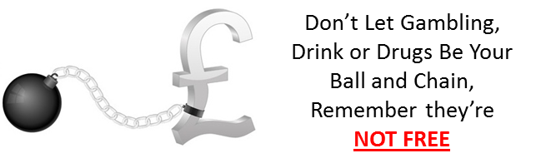
Gambling
Gambling debt can easily be accrued and grow at a rate that quickly becomes unmanageable.
All prisoners must be aware of the risks involved with gambling and how easy it might be to get drawn into placing bets.
Staff will discuss debt issues with prisoner’s when they see them playing cards and offer advice.
All other activities that might look like prisoners are placing bets on an outcome, will be considered as
Gambling is not acceptable behaviour and will not be tolerated.

Slide 47
Inside Advice / A Prisoners View
A major problem in prison is bullying, often a result of the way people manage their money (GETTING INTO DEBT WITH OTHER INMATES). The prison system can move you or the bully to try and resolve the situation but this is not always enough. People in prison don’t earn much and will always want their money back one way or another. The prison may even move you to another house block, but that won’t stop some more resourceful inmates from selling your debt on to others. As in the community, if you borrow, you must pay back, often with interest! Once you have got a bad name for debt in prison it sticks for a very long time, then when you do need help from one of the other inmates it won’t be there. If you can prioritize what you do earn to the essentials then you should get by O.K.
When you think of essentials, you should think about phone credit, stamps and if you smoke, tobacco! These are more important than chocolate, crisps and pop.
You will find people will come up to you and say “Have you got a burn for me bruv”. They are often people that spend their money on luxuries for themselves and rely on scrounging from others for things such as tobacco. This is because they consider their luxuries to come first, leaving you out of pocket. As a general rule of thumb these types of people never pay you back, and will try to make you feel guilty or pressured if you don’t give them something. These people will often say to you they are short this week because they didn’t get paid. The statement is most probably true, but the reason they didn’t get paid is normally because they either couldn’t be bothered to go to work or could not manage to behave themselves at work, or in the classroom, either way it’s normally their own fault.

Slide 48
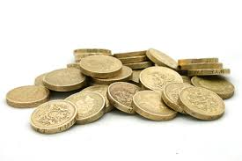
Emergency Phone Credit
This facility is very useful in the event of an emergency but has been abused by people who have forgotten to order PIN credit.
Don’t use this to try and get around the canteen system.
If you do and then genuinely need credit you will find it difficult to get.
Talk to your staff and explain any problems you have.

Slide 49
Money Management
Below is a easy to use form designed to help you manage your money more efficiently to prevent debt from happening to you.
Forms are available on each wing.

Slide 50








HMP/YOI Moorland – We will do all that we can to provide a Decent and Safe regime. But you have a Responsibility As Well - DO NO GET INTO DEBT!!!
HMP/YOI MOORLAND
You Will Be Given An
I.E.P Review
Personal Problems For You, Your Health And Your Family
The Consequences of
DEBT Whilst In Prison
It May Result In Cat D Refusal
You Will Not Be Transferred To Another Prison To Escape Your DEBT
It Will Have Negative Effects On HDC
Applications
You Will Not Be Relocated To The SEG

Slide 51






Life, Rehabilitation and Release
Losing Everything You Have Worked Hard For
Don’t get into DEBT!!!!!!
If you BORROW, USE, BUY or GAMBLE,
Remember there is always a PRICE
and its ALWAYS more than you expect.
STOP
AND
THINK
If you do get into DEBT seek HELP!
Don’t let it grow, It WILL Ruin
Everything you have worked hard
To achieve and earn.
DEBT WILL TAKE EVERYTHING YOU HAVE AND MORE
DEBT ! IS IT WORTH IT ???
HOW IT HAPPENS AND HOW TO GET HELP
Its Always Easier Not To Get Into DEBT Than It Is To Get Out Of It, REMEMBER THE CONSEQUENCES
We are here to HELP! We can
Show you how to work out your problems. BUT we will NOT solve them for you or help you RUN from them.
Don’t Let Gambling, Drink or Drugs Be Your Ball and Chain, Remember they’re NOT FREE

Slide 52

FINAL THOUGHT

